Slide 1
History of Cinema
From the French, “cinematographe” meaning “motion picture”

Slide 2
Early Years
17th -18th century: Lantern slides
19th century saw vast proliferation of visual forms of popular culture
Industrial Era
Books of photographs, illustrated fiction

Slide 3
Early Years
Middle/working class:
Visit circuses, amusement parks, music halls, theater troupes, dioramas, stereoscopes

Slide 4
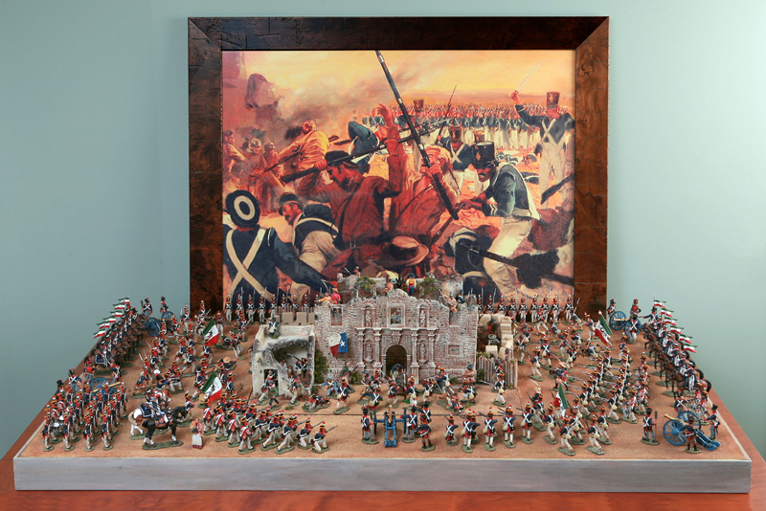
Diorama
Painted backdrops featuring 3-D figures depicting historical events

Slide 5
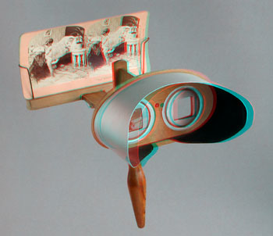
Stereoscopes
Hand-held viewers that created three dimensional effects by using oblong cards with two photographs printed side by side

Slide 6
Pre-conditions for Motion Pictures
1st: Scientists had to realize, the human eye will perceive motion if a series of slightly different images is placed before it in rapid succession-minimally around 16 per second.

Slide 7
Phenakistoscope (1832)
Deceiving scope
http://www.youtube.com/watch?v=dAoa0mv2id4

Slide 8
Zoetrope (1833)
Life + turn
http://www.youtube.com/watch?v=-3yarT_h2ws

Slide 9
Pre-conditions for Motion Pictures
2nd: these fast-moving images needed to be projected on a surface
17th Century “magic lanterns” projecting glass lantern slides (paintings illuminated by glass), but couldn’t flash large numbers of images fast enough to create illusion of motion.

Slide 10
Pre-conditions for Motion Pictures
3rd: Ability to use photography to make successive pictures on clear surface
Speed up exposure time

Slide 11
Exposure
the act of presenting rays of light to a photosensitive surface.
First photograph/frame had exposure time of 8 hours (1839)
Motion pictures=split-second exposure
This became feasible in 1878

Slide 12
Pre-conditions for Motion Pictures
4th: Photographs needed to be printed on a base flexible enough to be passed through a camera rapidly.
1888: George Eastman devised a camera that made photographs on rolls of thin paper. Kodak!
The next year, he introduced transparent roll of film creating a breakthrough in the move toward cinema.

Slide 13
Pre-conditions of Motion Picture
5th: Needed to find a suitable mechanism for cameras and projectors.
The camera: the film strip had to stop briefly while light entered through the lens and exposed each frame; a shutter then covered the film as another frame moved into place.

Slide 14
Shutter
a mechanical device for opening and closing the aperture of a camera lens to expose film or the like.

Slide 15
Aperture
an opening, usually circular, that limits the quantity of light that can enter an optical instrument.

Slide 16
Major Pre-cursors of Motion Picture
Eadward Muybridge (1878) and the running horses
Photographer
Row of 12 cameras, each making an exposure in one-thousandth of a
Second.
Lantern to project the images which were eventually drawings copied
from the photographs onto a revolving disk
See attached video.

Slide 17
Invention of the Motion Picture
Thomas Edison developed Kinetoscope in 1891 the first motion picture system (peep show in a box)
Scottish-English immigrant William Dixson joined Edison’s team to help develop the technology that would combine pictures and sound
Looped in :30 vignettes, no story connecting them.
Boxing Cats

Slide 18
Kinetoscope
A phonograph inside the cabinet. The viewer would look into the peep-holes of the Kinetoscope to watch the motion picture while listening to the accompanying phonograph through two rubber ear tubes connected to the machine. The picture and sound were made somewhat synchronous by connecting the two with a belt
46 frames per second

Slide 19
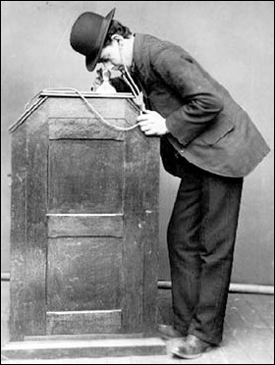
Kinetoscope

Slide 20
The Bioscop
Invented by Skladanowsky brothers
Held two strips of 3 ½” film running side by side-frames projected alternately
15 minute programs
Too cumbersome

Slide 21
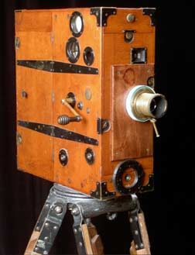
The Bioscop

Slide 22
The Lumiere Brothers
Invented a projection system that helped make cinema a commercially viable enterprise internationally!!
Designed the “cinematographe”
35 mm film
16 frames per second

Slide 23
Lumiere Brothers
Workers Leaving the Factory, 1895

Slide 24
American Developments
Edison’s Kinetoscope evolved into Vitascope (life scope) October 1895
Rough Sea at Dover
Inventor, Thomas Armat created Vitascope and Edison manufactured it.
1894: American Mutoscope Company
70 mm film that yielded larger, sharper images

Slide 25
American Developments
1897: 2 means of film exhibition
Peep show devices for individual viewing
Projection systems for audiences
Types of cinema:
Scenics, topicals and fiction films

Slide 26
Scenics
Short travelogues offering views of distant lands

Slide 27
Topicals
News events, recreations of key occurrences in studio
Sinking of battleship Maine during Spanish-American War (1898)

Slide 28
Fiction Films
Brief staged scenes telling a story
Some shot outdoors, but most shot in front of painted backdrops
1904-became the industry’s main product
Camera set up in one position and action unfolded in one continuous take.
No credits, music
Provided live
by the “exhibitor”

Slide 29
American Developments
1905- Admission to Nickelodeon (movie theater) = $.05-$.10 for a 15-60 minute production
Audiences sat on benches, wooden seats
Front display=hand painted signs
Actors stood behind screen and spoke dialogue in synchronization with the action on the screen
Sound effects were made with noisemakers behind the screen
Warner Bros., Universal, Paramount, MGM got there start as Nickelodeon exhibitors

Slide 30
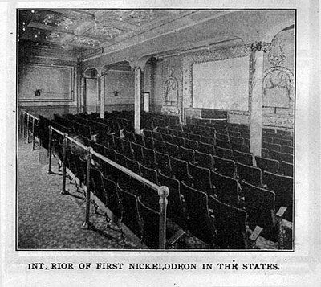
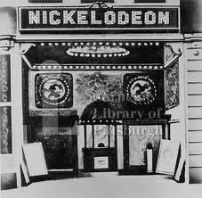
Nickelodeon

Slide 31
American Cinema: Pre WWI
Industry professionals focused on swiftly expanding the demand for film in America
Nickelodeon theaters were clustered in business districts and working-class neighborhoods
1908 Nickelodeons were the main form of exhibition
Most films came from abroad
Studio System born from the Nickelodeon boom

Slide 32
American Cinema: Pre-WWI
Edison company vs. American Mutoscope and Biograph
Conflicts over camera patents and equipment licensing distracted the two companies from the distribution aspect.
Two companies decided to cooperate-created Motion Pictures Patent Company that owned and charged licensing fees on key existing patents.
Production companies had to pay MPPC licensing fees in order to exist.

Slide 33
Patent
An invention or process protected by this right
The Vitascope

Slide 34
American Cinema: Pre-WWI
MPPC limited number of foreign companies
MPPC’s goal was to control all three aspects of the industry: production, distribution and exhibition.
Only licensed companies could produce, distribute and exhibit films=oligopoly
Eastman Kodak only sold films to MPPC licensed companies, etc.

Slide 35
Production
The whole creative process involved in the making of a film (shooting footage, set design, costume, directing, editing, etc)

Slide 36
Distribution
The process of selling and marketing the film

Slide 37
Exhibition
The process of showing the film in theaters
Exhibitors were those who owned and operated theaters and were involved in the buying/renting process of films.

Slide 38
Oligopoly
When a small number of firms cooperate to control the market.
In the film industry, when any other unlicensed firmed attempted to shoot, distribute, or exhibit a film, MPPC would threatened to sue for patent infringement.
Monopoly: when one firm controls the market

Slide 39
American Cinema: Pre-WWI
The independents fought back!!
6000 theaters agreed to pay the fees to MPPC
2000 refused
A market for unlicensed producers and distributors was created by these 2000
This portion of the industry was identified as the independents.

Slide 40
Independents
A group of professionals in the film industry who were not licensed through the MPPC to create, distribute, and exhibit films.

Slide 41
American Cinema: Pre WWI
The Independent Movement
Independent Motion Picture Company, New York Motion Picture Company
These companies could rent films from European companies that MPPC had shut out.
To avoid patent infringement suits they claimed to be using cameras that employed different mechanisms than Edison’s.

Slide 42
American Cinema: Pre-WWI
The MPPC retaliated and created the General Film Company in 1910 in an attempt to monopolize the distribution aspect of filmmaking.
GFC released ALL films made by MPPC producers.
MPPC also hired detectives to investigate the Independents claims in regards to mechanisms.
MPPC lost a key suit where IMP claimed to be using a different mechanism and after investigations, the court ruled that this particular mechanism had been anticipated in earlier patents, so therefore was not a violation
This freed all independents from the fear of infringement law suits!!!

Slide 43
American Cinema: Pre-WWI
After key loss, MPCC suffered, and many independents began banding together.
It was during this time that the feature film length was established AND it was the birth of the Hollywood Studio System.

